Slide 1
Student Performance Monitoring System (SPMS)
Presented By
Shoeb Uddin Ahmed 1920038
Istiak Ahammad Limon 1930038
Tahsin Bin Khaled 1830422
Syeda Ramisa Shams Mahmood 1720180
Maria Hasan Logno 1720469

Slide 2
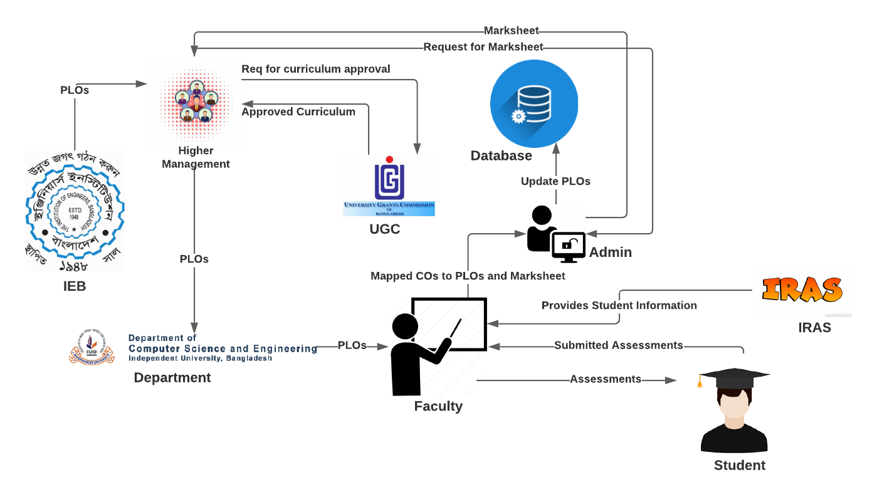
Rich Picture (Existing system)

Slide 3
Problem Analysis
The Faculty members have to provide the mark sheet to Admin and then the Admin enters the mark sheet into the Database. This process becomes too time-consuming and uses up a lot of extra resources.
The CO, PLO achievement analysis has to be done by the faculty by manually entering marks of each student to finalize whether they pass or fail. The analysis has to be sent to the admin to be uploaded to the database. The entire CO, PLO achievement analysis table, and the passing of the data is extremely time-consuming.

Slide 4
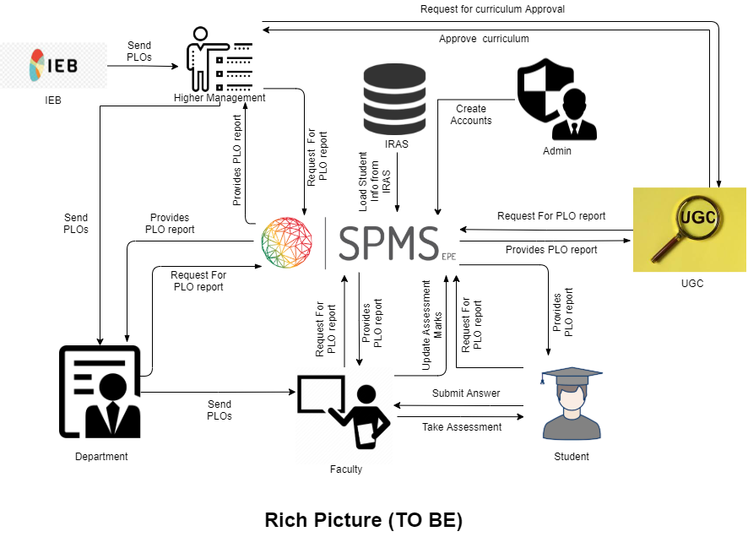
Rich Picture (Proposed system)

Slide 5
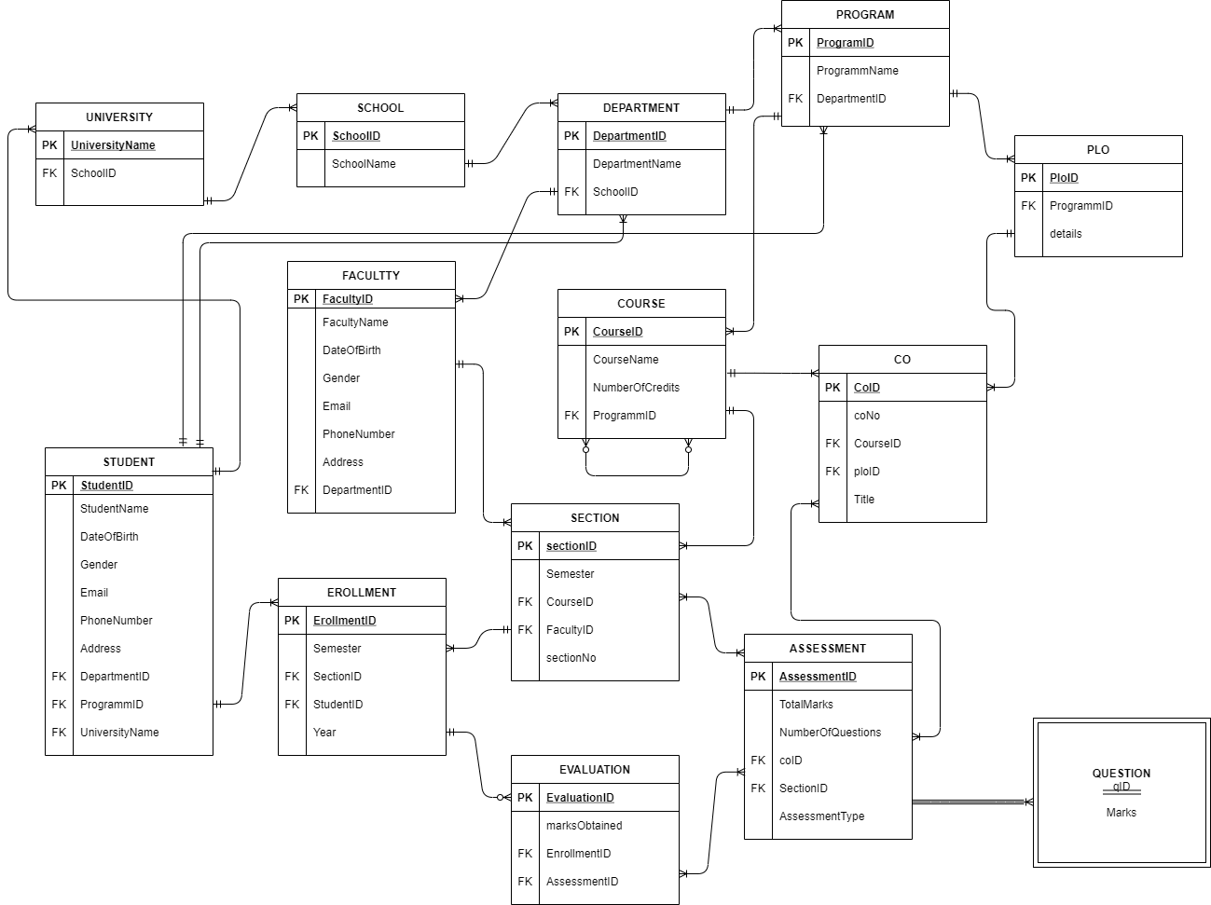
Entity Relationship Diagram (ERD)

Slide 6
universityName➔ | schoolID
SchoolID➔ | SchoolName
DepartmentID➔ | DepartmentName, SchoolID
ProgramID➔ | programName, DepartmentID
FacultyID➔ | facultyName, gender, dateOfBirth, email, phone, address, DepartmentID
StudentID➔ | studentName, dateOfBirth, gender, email, phone, address,DepartmentID,ProgramID,universityName
CourseID➔ | courseName, noOfCredits, courseType, ProgramID
ploID➔ | ploNo, details, ProgramID
coID➔ | coNo, ploID, CourseID, title
SectionID➔ | sectionNo, semester, CourseID, FacultyID
EnrollmentID➔ | semester, year, SectionID, StudentID
assessmentNo➔ | ocID, SectionID,assessmentType, NumberOfQuestions
EvaluationID➔ | evaluationNo, obtainedMarks, assesmentNo, EnrollmentID
DEPENDENCY TABLE

Slide 7
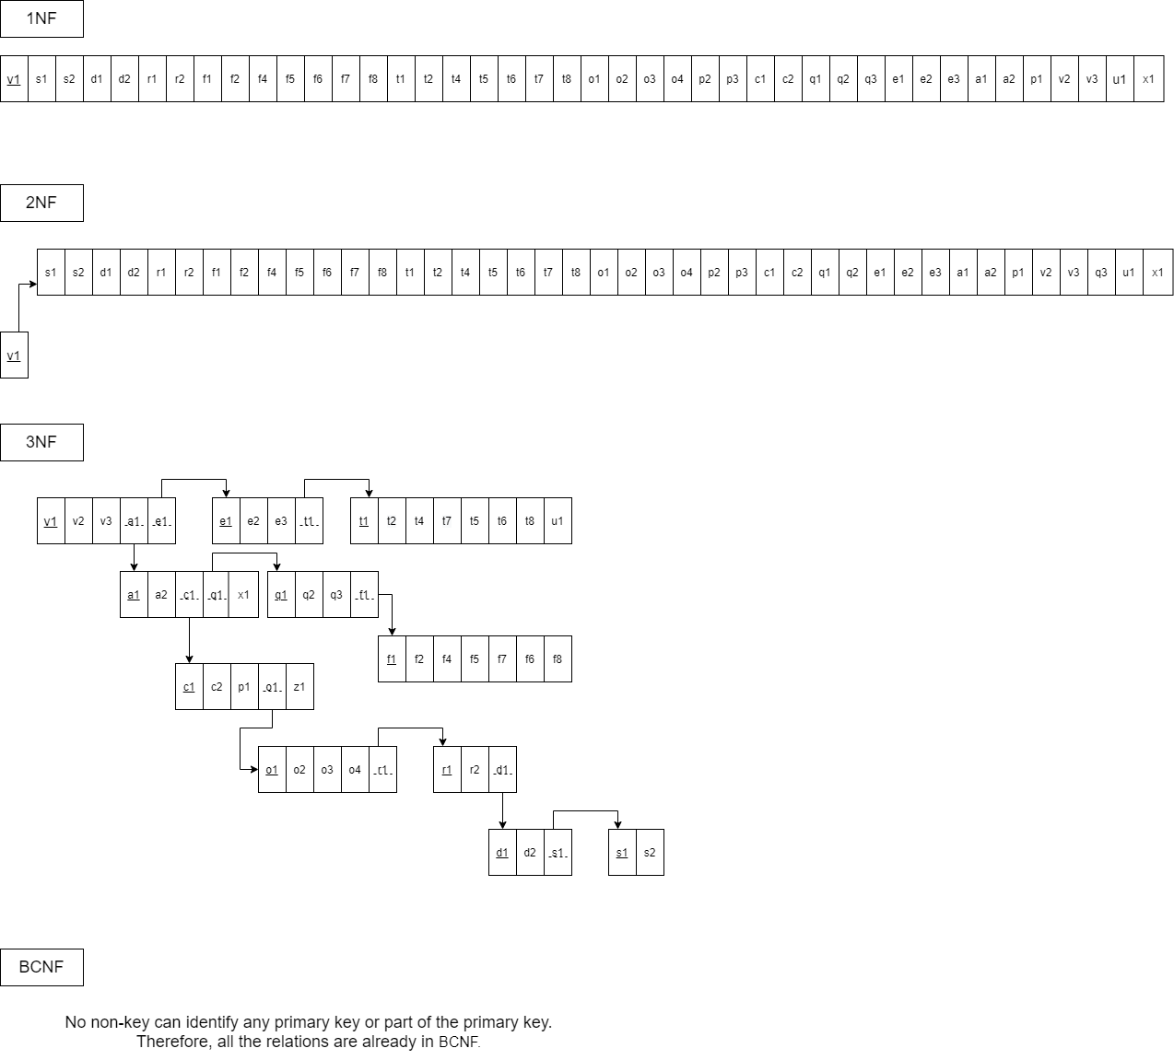
NORMALIZATION

Slide 8
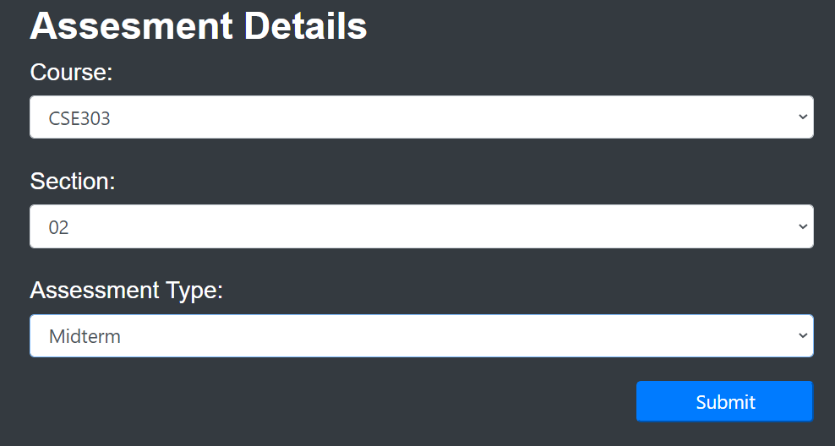
INPUT FORMS
Assessment Details

Slide 9
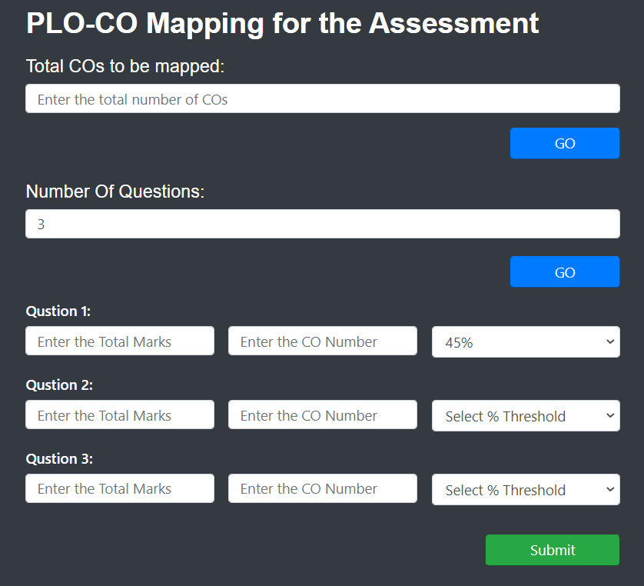
PLO-CO mapping for the assessment

Slide 10
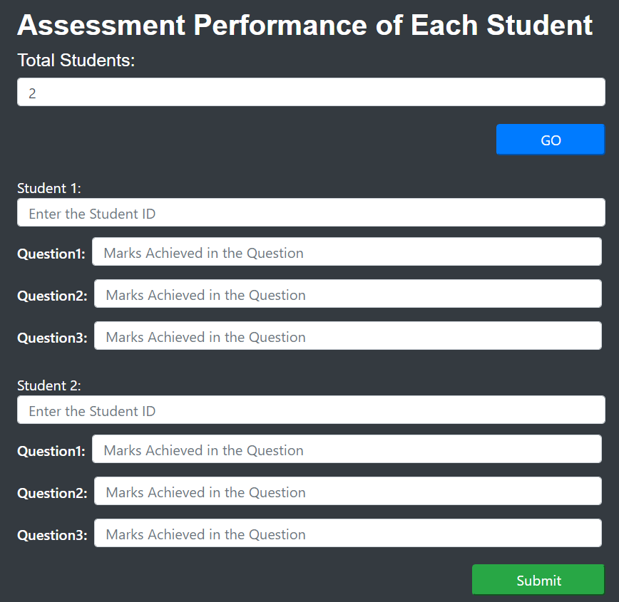
Assessment performance of each student

Slide 11
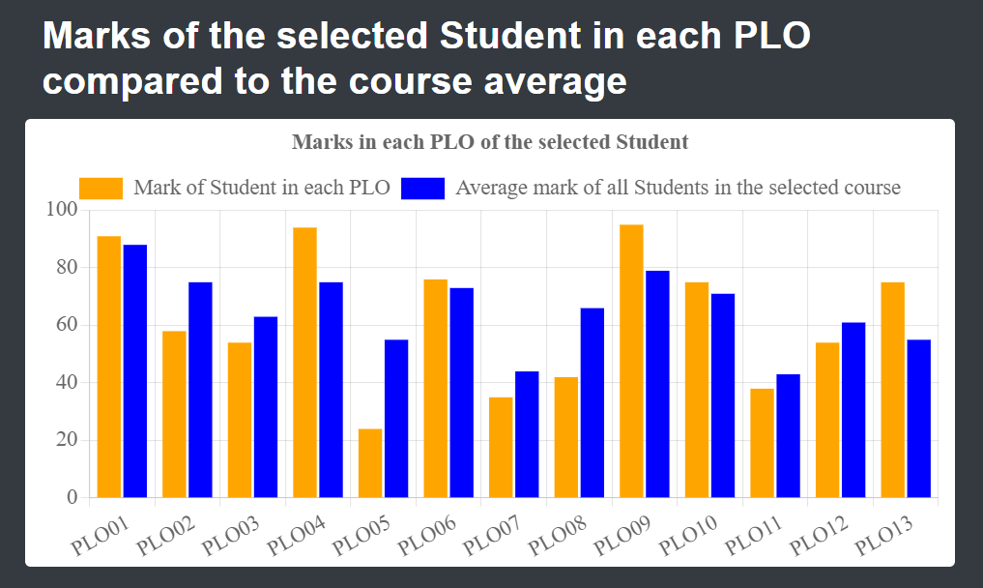
OUTPUT VIEWS
Student Wise PLO ANALYSIS (Faculty UI):

Slide 12
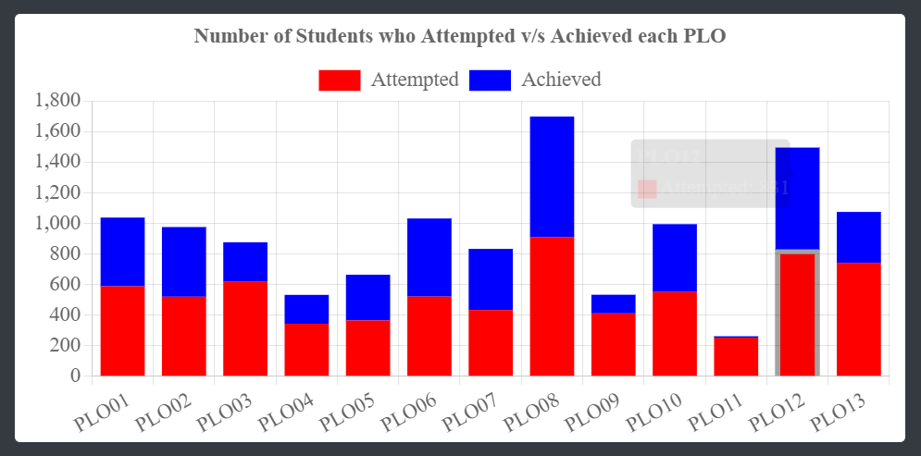
PLO attempted VS Achieved By Students (Faculty DashBoard):

Slide 13
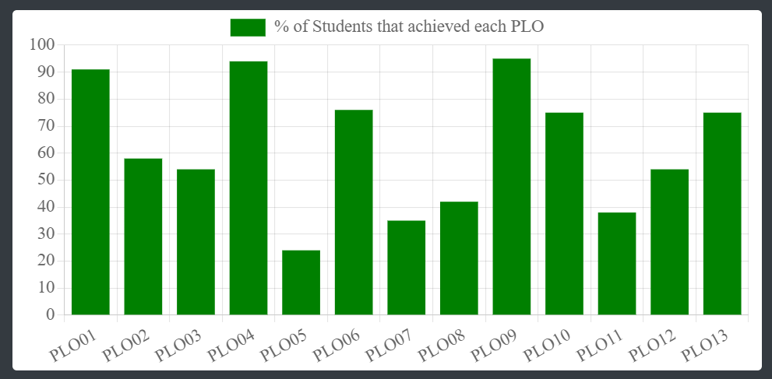
COURSE WISE PLO ANALYSIS (Faculty UI):

Slide 14
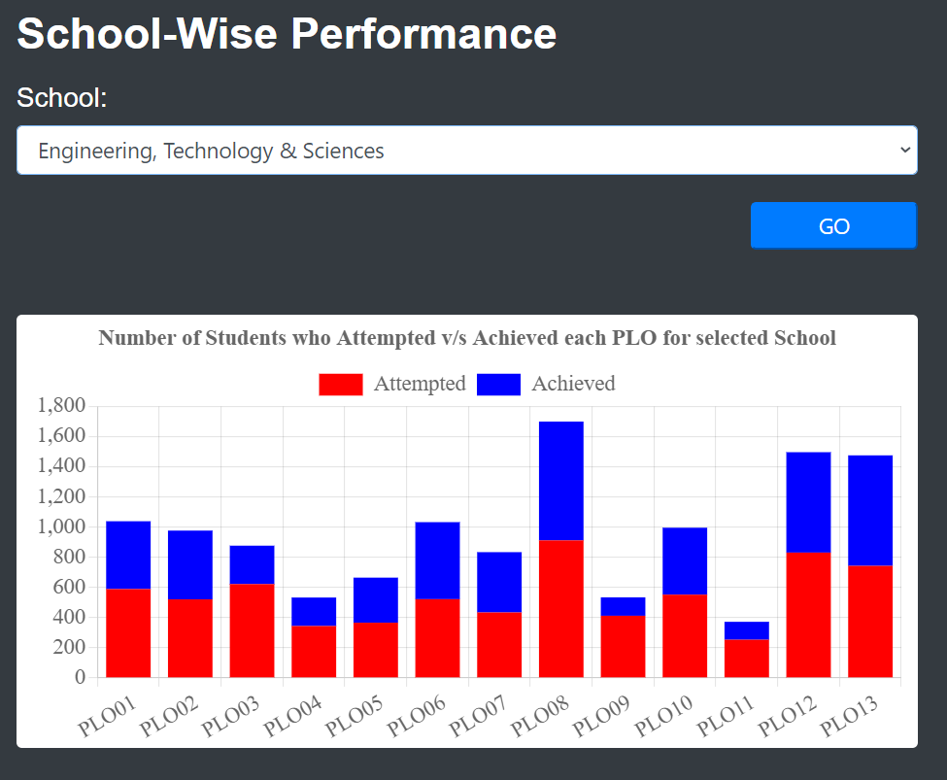
School-wise number of students attempted vs achieved for each PLO:

Slide 15
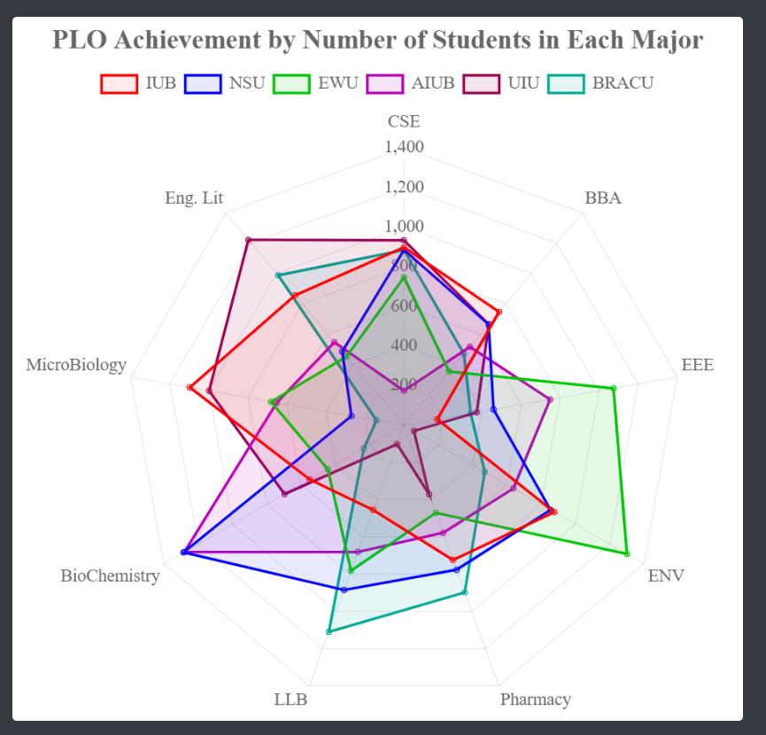
University Wise PLO ANALYSIS:

Slide 16


